Slide 1
GDP-I Final Presentation
Team Members:
Kopparthi Sai Dinesh,
Chepuri Tagore Charith,
Emani Aasrita,
Dasari Vamshika,
Maddela Tejaswi,
Veldanda Sailaxmi

Slide 2
Contents
Work Completed
Requirement Gathering
Defining Scope and Objectives
Wireframes Design and Creation
Navigation for Wireframes
Research into Development Environment Setup
Defining System Architecture
XML Layout for Login Screen
Java Implementation for Login Screen
XML Layout for Departments Screen
Contribution

Slide 3
Work Completed – Requirement Gathering
Develop a user-friendly institutional Android Application with the following components:
Login screen
Department Screen
Programs Screen
Course Screen
Assignment Screen
Student Dashboard Screen
Program that manipulates data in multiple CSV files to create a single CSV that stores relevant data.
Based on the role of person (Administrator, Instructor) who sign-in into the application, the data being displayed in the application needs to be changed.
1

Slide 4
Work Completed – Defining Scope and Objectives
Weekly objectives
Week 1 - 2 : Requirement gathering, defining scope and objectives
Week 3 - 5: Wireframes Design and Creation
Week 6- 9: Development Environment Setup
Week 10 - 14: Development – XML Layout Designs and Navigation
2

Slide 5
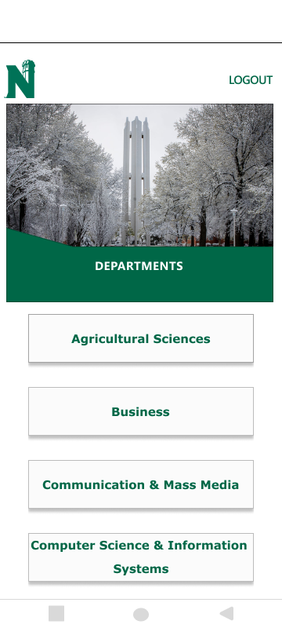
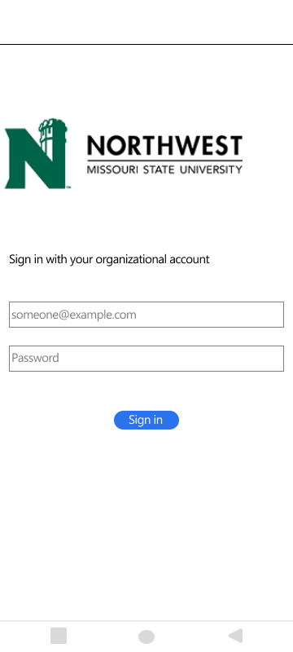
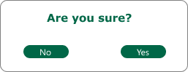
Work Completed – Wireframes Design and Creation
Stays on the same page
Redirects to login screen
Text fields to enter Username and Password
Sign in Button: Validates Credentials and takes to departments screen
View to select departments
Login Screen
Departments Screen
3

Slide 6
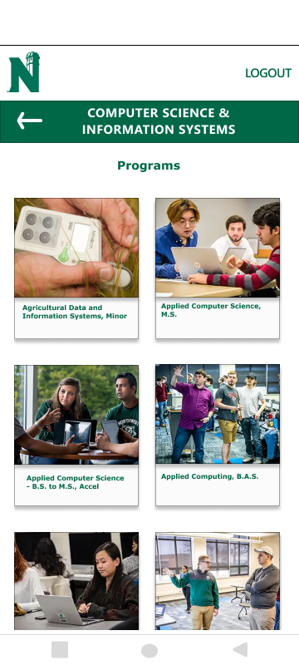
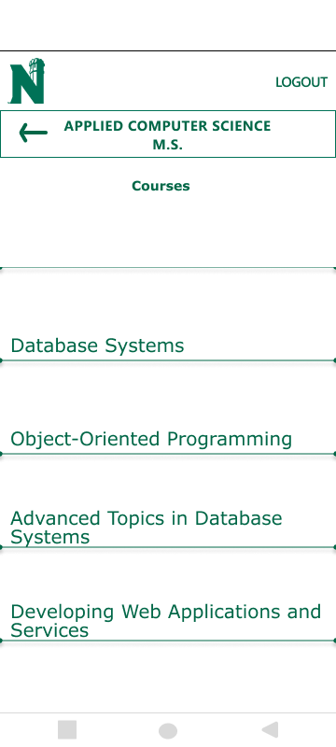
Work Completed – Wireframes Design and Creation
Redirects user to previous screen
View to select Program
View to select Course
Programs Screen
Courses Screen
4

Slide 7
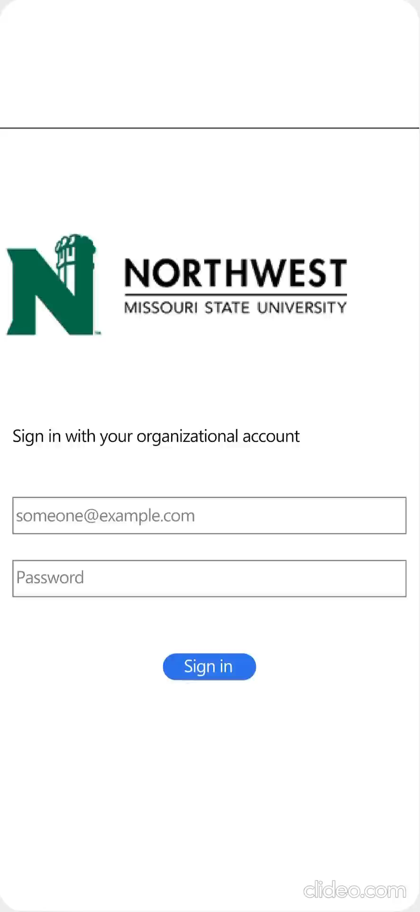
Work Completed - Navigation for Wireframes
5

Slide 8
Work Completed - Research into Development Environment Setup
Branch Workflow:
Create two main branches - master and development.
Team members create feature branches from development for their work.
Work is done in these feature branches to isolate changes.
Collaboration and Review:
After completing work, initiate a merge request from the feature branch to development.
Team reviews changes, ensuring code quality and functionality.
If approved, merge into development; else, iterate on improvements.
Stable Releases:
Periodically merge development into master to create stable releases.
6

Slide 9
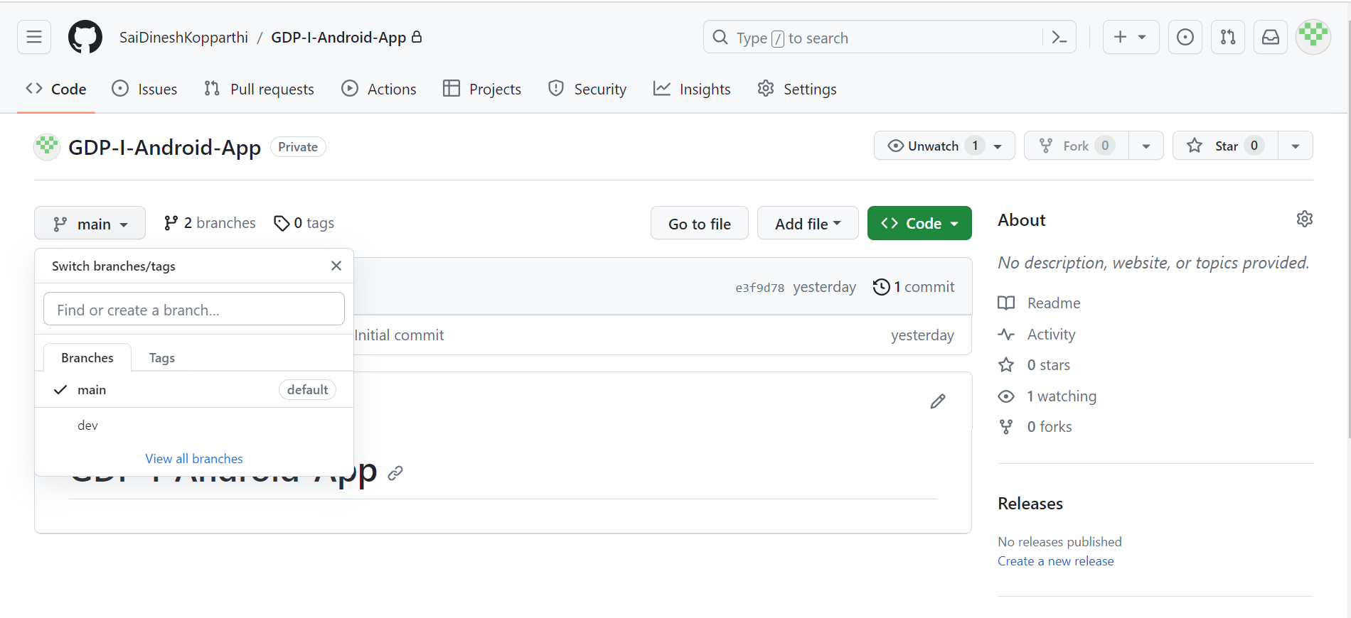
Work Completed - Research into Development Environment Setup
Branch ‘main’ : Source code hosting.
Branch ‘dev’: Branch for development.
7

Slide 10
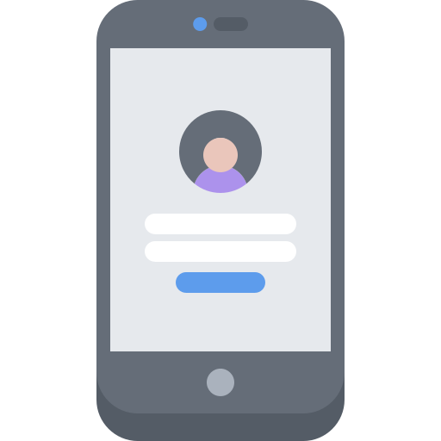

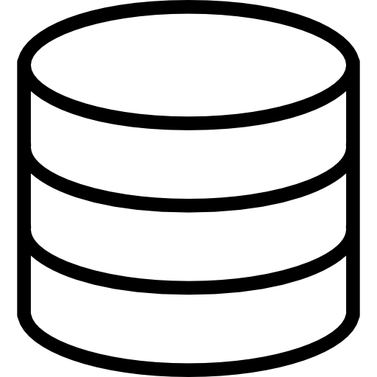
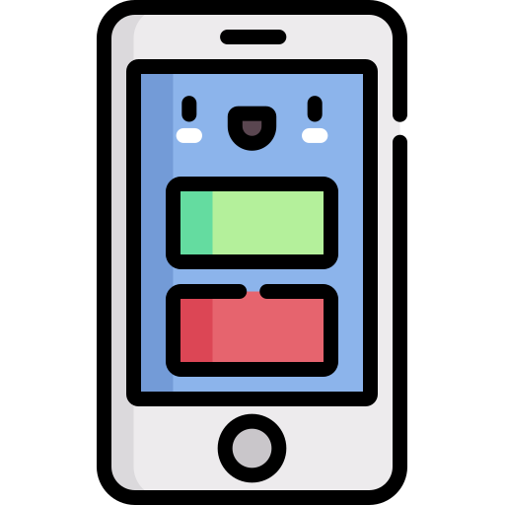
Work Completed – System Architecture
Frontend
Backend
Authentication
Server
Database
User Interface
8

Slide 11
Work Completed – System Architecture
Proposed Tools and Technologies:
User Authentication:
Firebase Authentication: A popular authentication service by Google that provides secure user sign-ins.
User Interface:
XML Layout: To define the structure and appearance of UI components within Android app screens.
Server:
Node.js: Backend frameworks for server development.
Database:
Firebase Realtime Database, Firebase Firestore.
Data Parsing:
Java: CSV parsing using libraries like Apache Commons CSV.
Python: Built-in ‘csv’ module.
9

Slide 12
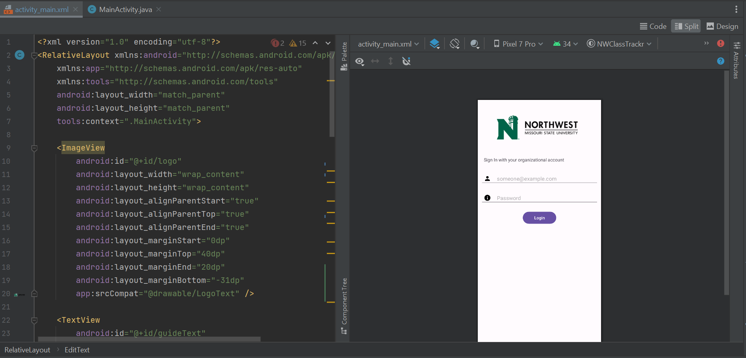
Work Completed – Login Layout
Creation of constrained XML layout for login screen
Design View for the Login Screen
XML code for the login screen
10

Slide 13
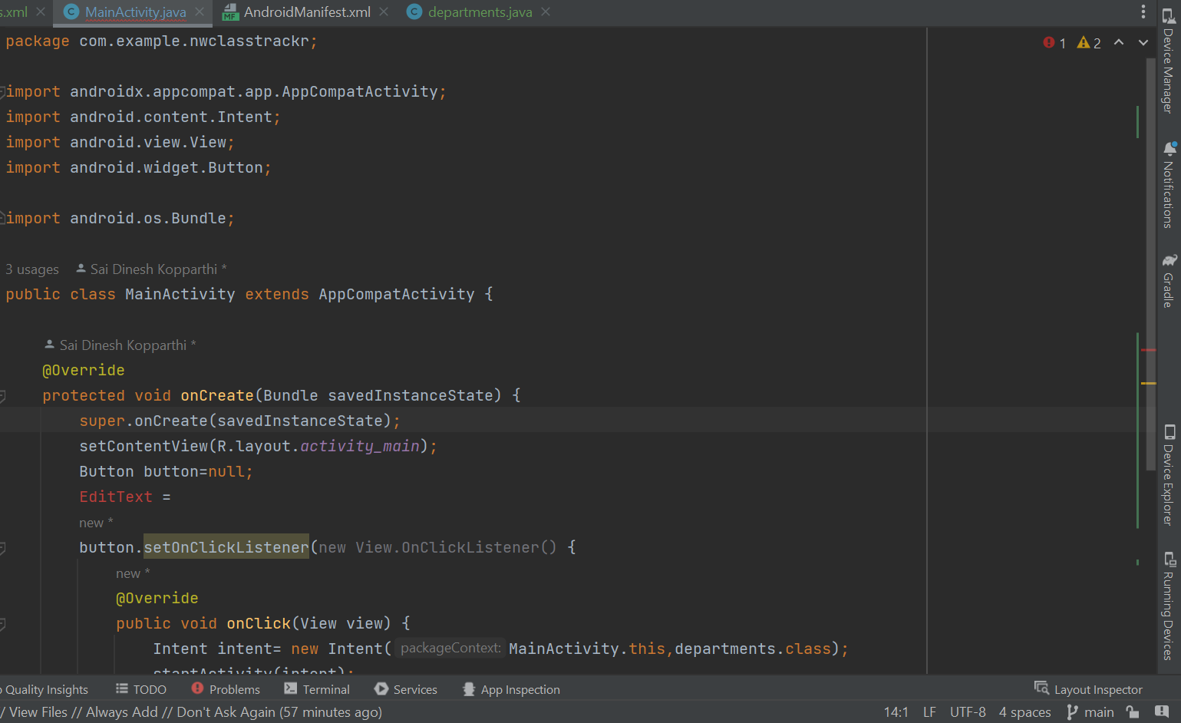
Work Completed – Java Implementation
Code to initiate Navigation from Login screen to Departments Screen
11

Slide 14
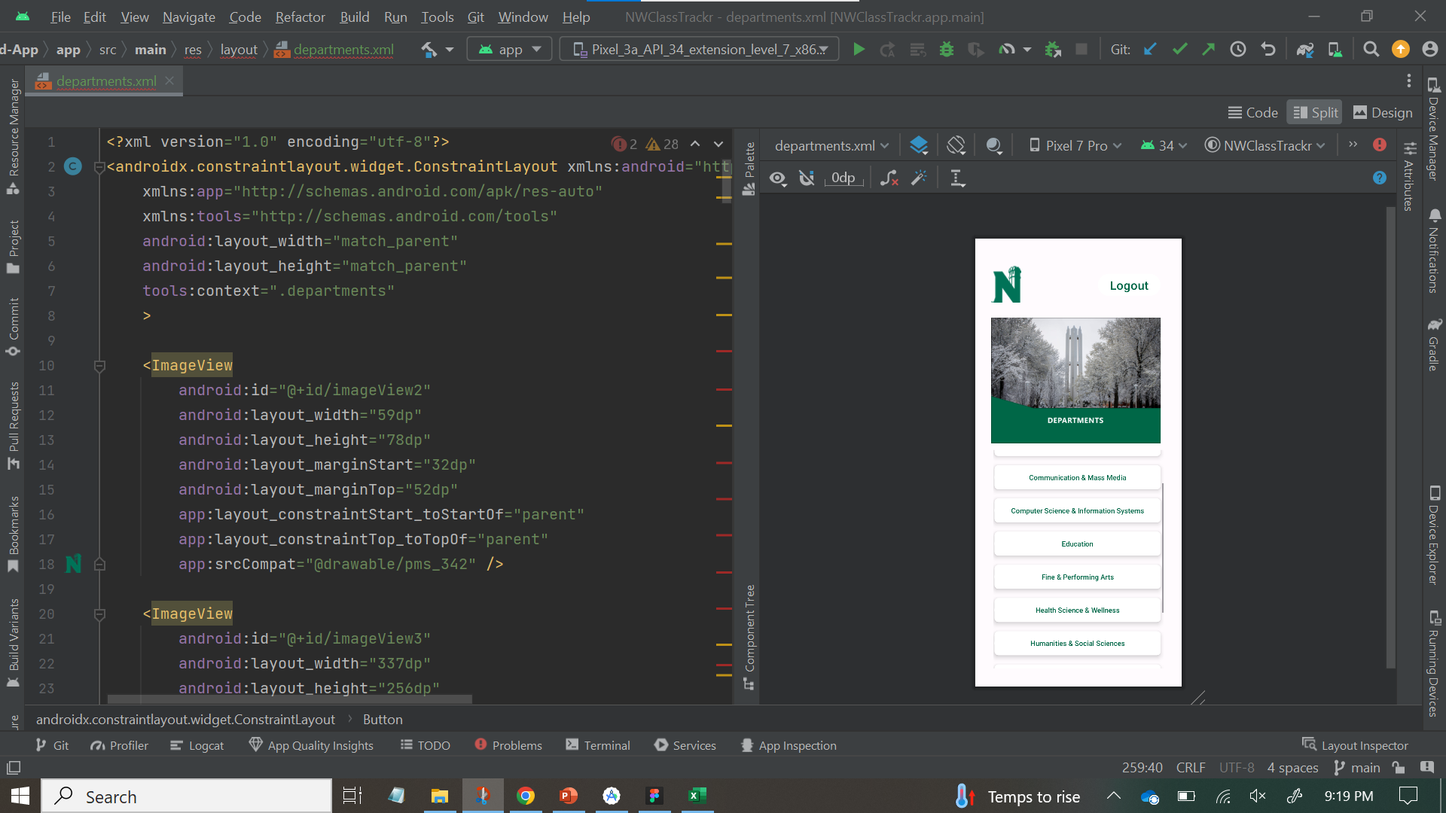
Work Completed – XML Layout
XML Code for the department screen
Design view with embedded scroll view and each buttons embedded inside a card view widget
12

Slide 15
Contribution
Kopparthi Sai Dinesh
Developing designs for both the departments and programs screens.
Conducting research pertaining to the establishment of a development environment.
Setting up of git repository and implementing required branch settings.
Installed tools required for application development and integrated project with GitHub. Research into Firebase for database.
Creation of XML layout for login screen.
Java Code for navigation – login to departments. Research into tools and technologies for project
Implementing card view widget in the XML Layout
Chepuri Tagore Charith
Compiling the design elements for the departments screen to finalize the wireframe.
Designing the navigation structure for the wireframes.
Research into tools and technologies and develop environment.
Installed tools required for application development and integrated project with GitHub
Java Code for navigation – login to departments
Creation of XML layout for login screen.
Implementing card view widget in the XML Layout
13

Slide 16
Contribution
Veldanda Sailaxmi
Collecting data pertaining to the departments and programs at Northwest Missouri State University and storing it in an Excel file.
Designing and compiling the elements for the courses screen to finalize the wireframe.
Defining the system architecture for the application.
Installed tools required for application development and integrated project with GitHub
Identifying the configuration issues within the project and creating a new project with suitable configurations.
Java Code for navigation – login to departments
Implementing Scroll view in the XML Layout
Emani Aasrita
Designing and implementing the wireframe for the application's login screen.
Assembling the design elements for the program screen and courses screen.
Defining the system architecture for the application.
Installed tools required for application development and integrated project with GitHub
Identifying the configuration issues within the project and creating a new project with suitable configurations.
Creating XML Layout for departments Screen
Adding and customizing buttons in the XML Layout
14

Slide 17
Contribution
Dasari Vamshika
Compiling the design elements for the programs screen to finalize the wireframe.
Designing the navigation structure for the wireframes.
Research into tools and technologies for the application.
Installed tools required for application development and integrated project with GitHub
Going through the firebase documentation to integrate the firebase project to android project.
Creating XML Layout for departments Screen
Adding and customizing buttons in the XML Layout
Maddela Tejaswi
Collecting data pertaining to the departments and programs at Northwest Missouri State University and storing it in an Excel file.
Assembling the design elements for the program screen and courses screen.
Research into tools and technologies for the application.
Installed tools required for application development and integrated project with GitHub
Going through the firebase documentation to integrate the firebase project to android project.
Creating XML Layout for departments Screen
Implementing Scroll view in the XML Layout
15

Slide 18
THANK YOU

